Slide 1
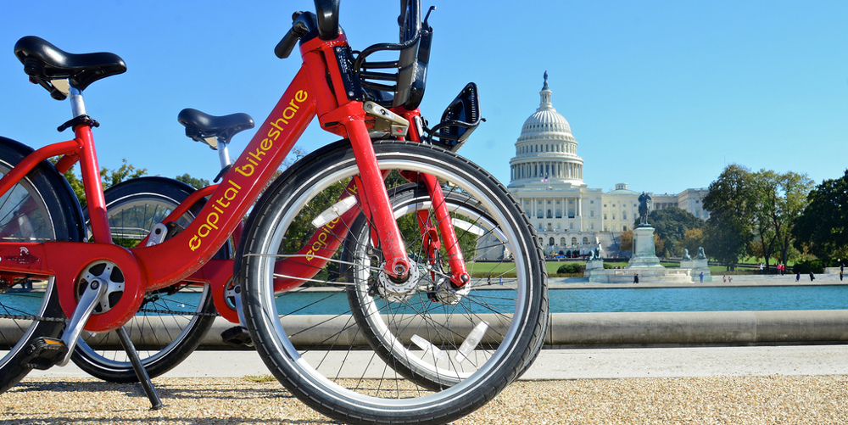

Data
Kimball Wu
Pei-Yi Cheng
Ling Tan
Sumeet Mishra
Notes:
Sumeet

Slide 2
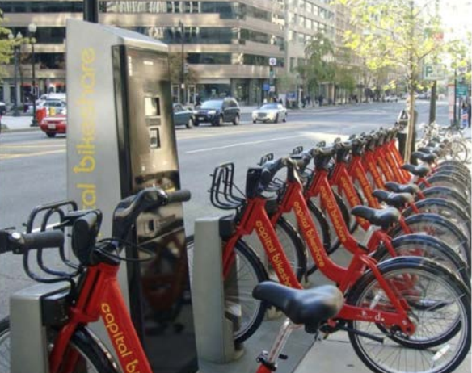
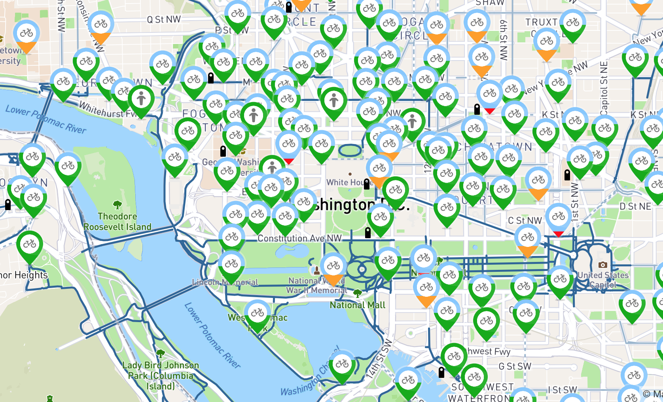
Notes:
Sumeet

Slide 3
Introduction
We are going to answer the following questions:
Capital Bikeshare has provided an eco-friendly alternative way to commute around D.C other than taking the Metro or driving.
-- We want to bring more profit to the company, by analyzing traveling behavior of bike usage:
Introduce new promotions that would interest Capital Bikeshare (potential) users.
Decrease bike maintenance cost.
Notes:
Sumeet
Time
Weather variations
Type of membership

Slide 4
Backgrounds
Count (Casual Registered)
Data Collection
Hourly and daily count of rental bikes between years 2011 and 2012
With corresponding weather and seasonal information
Dataset & Attributes
Response variable
Count
Temporal variables
Hour
Workingday
Month
Year
Weather variables
Temperature
Humidity
Windspeed
Weather
Membership variables
Casual User (Single Trip & Pass)
Registered (Yearly or Monthly Membership)
Notes:
Sumeet
Indicates whether user was a "registered" member (Annual Member, 30-Day Member or Day Key Member) or a "casual" rider (Single Trip, 24-Hour Pass, 3-Day Pass or 5-Day Pass)

Slide 5
We need to explore the following relationships:
How is the bike usage affected by:
Type of Days
Seasons
Different type of Weather Conditions
Temperature, Humidity
Fitted and Predicted Models
Notes:
Sabrina

Slide 6
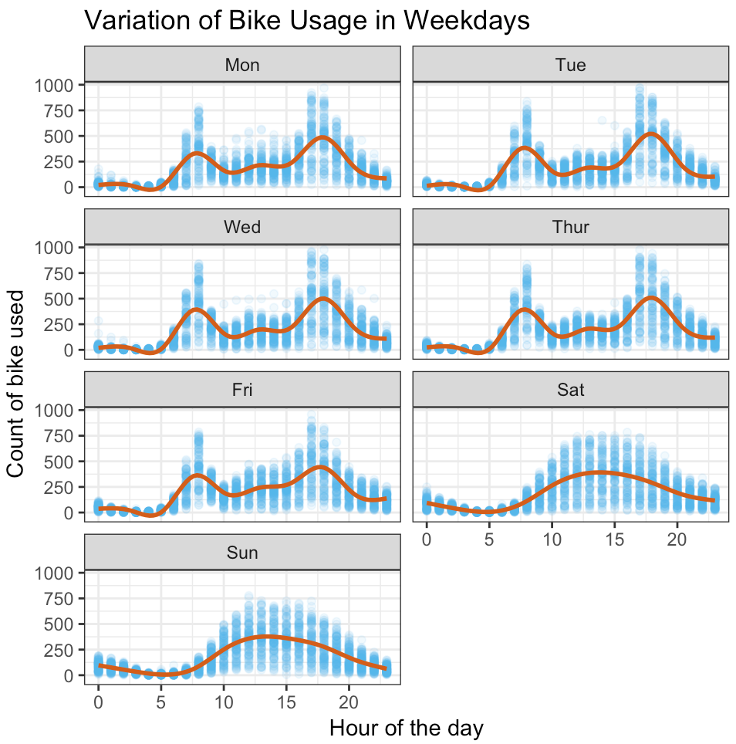
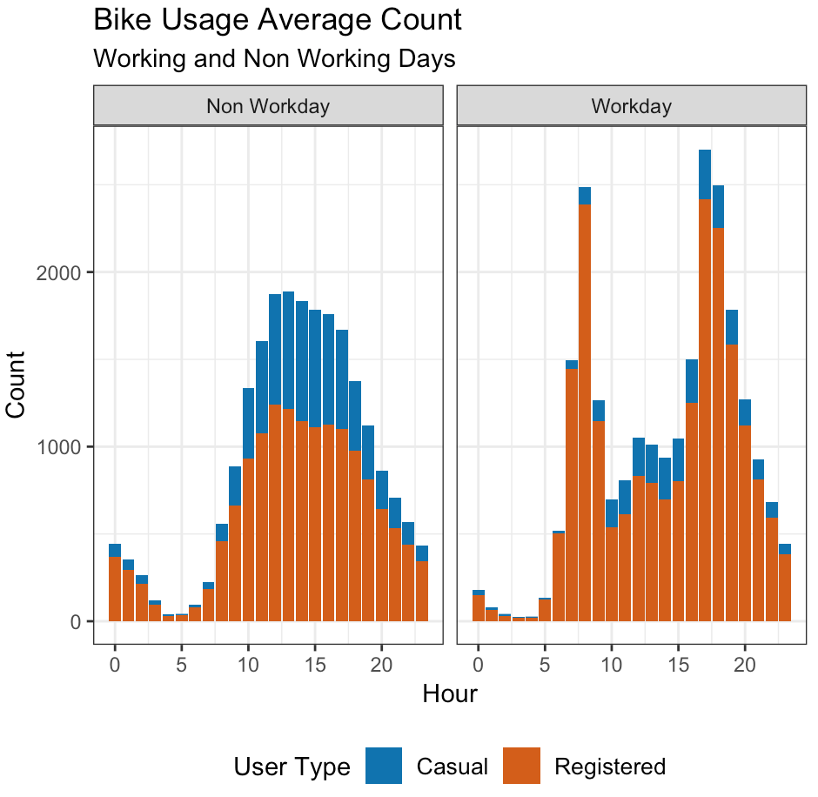
How bike usage are affected by different day of and hour
Notes:
Sabrina

Slide 7
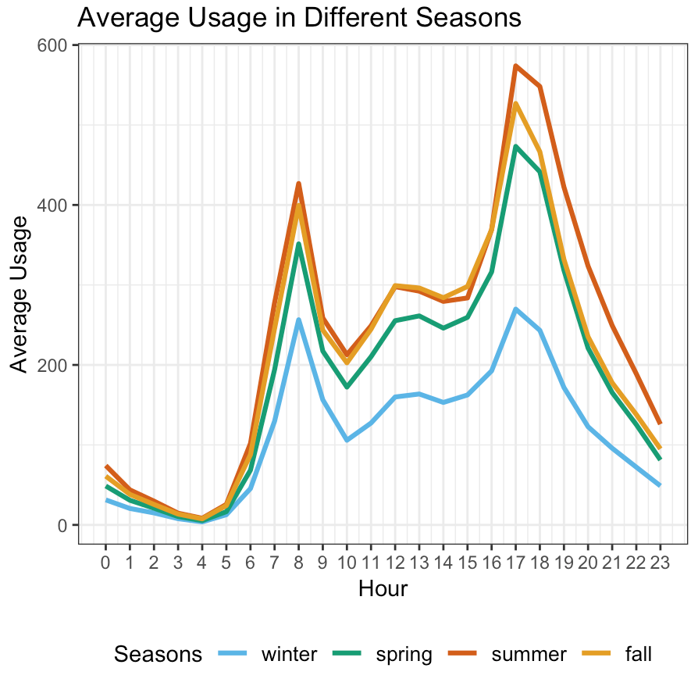
How bike Usage are affected by seasons
Notes:
Kimball

Slide 8
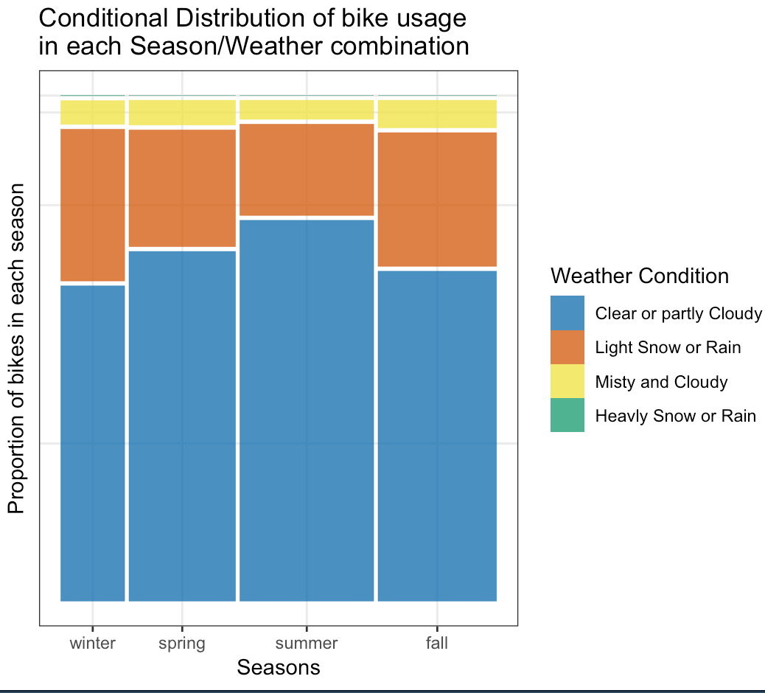
How bike Usage are Affected by
Weather Conditions and Seasons
Notes:
Kimball

Slide 9
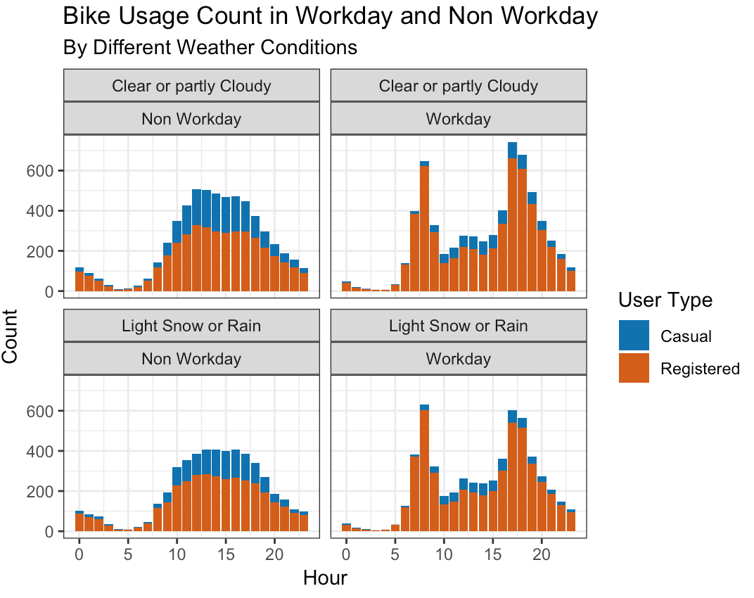
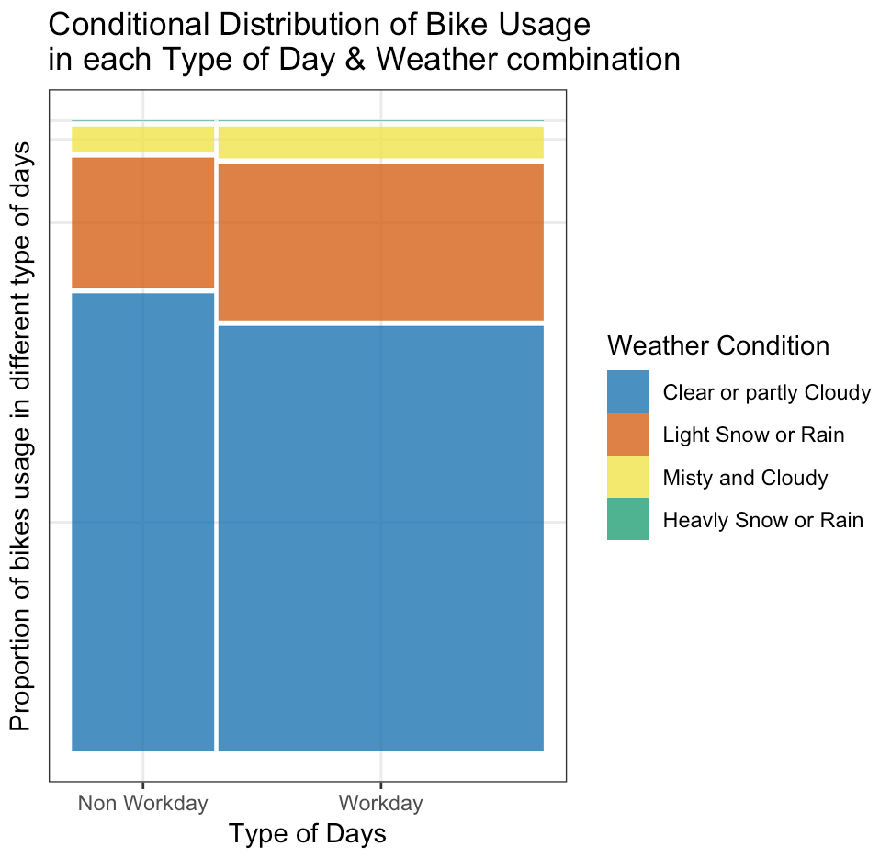
How bike Usage are Affected by
Weather Conditions and Type of Days
Notes:
Kimball

Slide 10
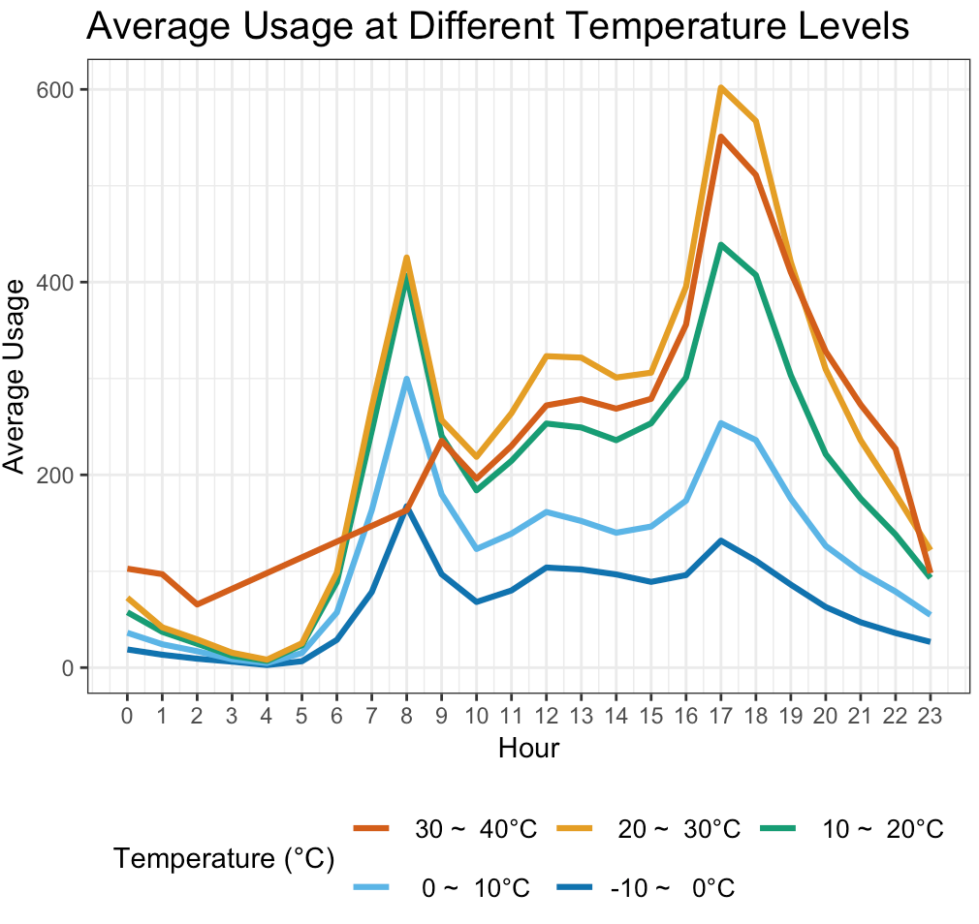
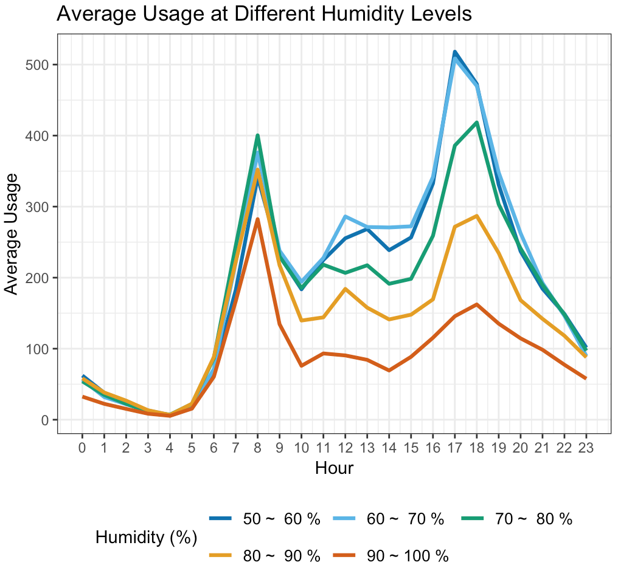
How bike Usage are Affected by
Temperature and Humidity Levels on Average
Notes:
Kimball

Slide 11
Conclusions so far
Bike usage shows a very different pattern at different kind of days
Work and non-work
On workday more bike usage during rush hours
More bikes are been used in summer and fall
Bike usage drops considerably at more severe weather conditions
Bike usage drops when temperature or humidity increases
Notes:
Kimball

Slide 12
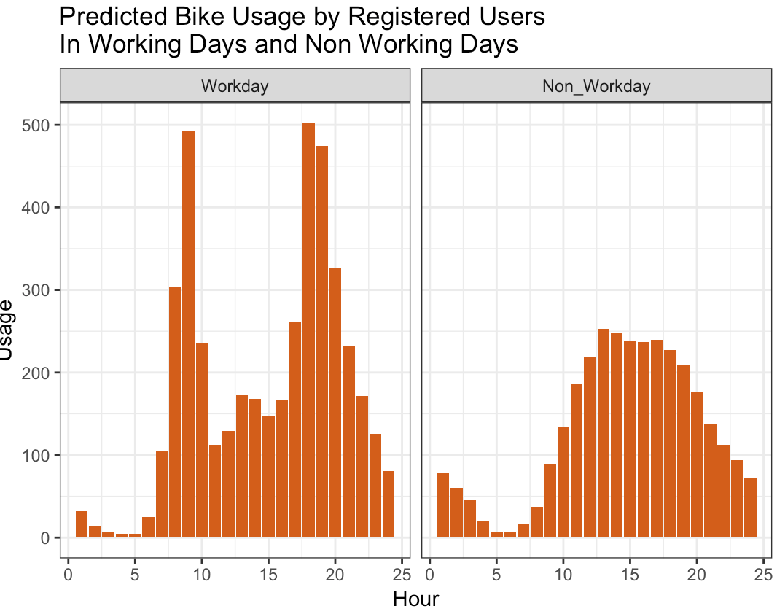
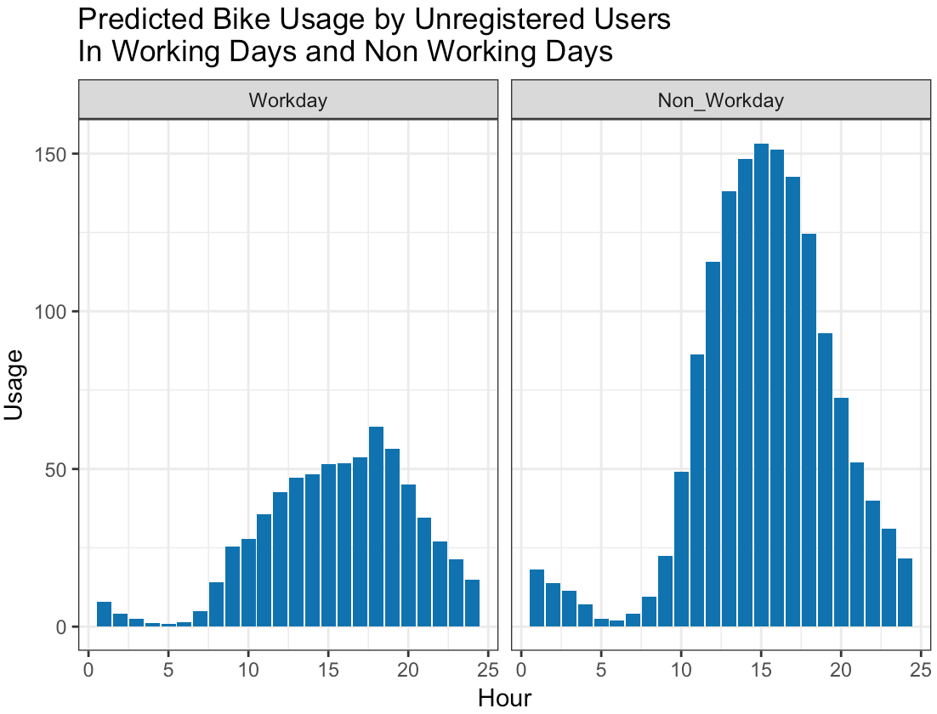
Poisson Prediction Model
Types of day x Hours + Normal Weather
Notes:
Ling

Slide 13
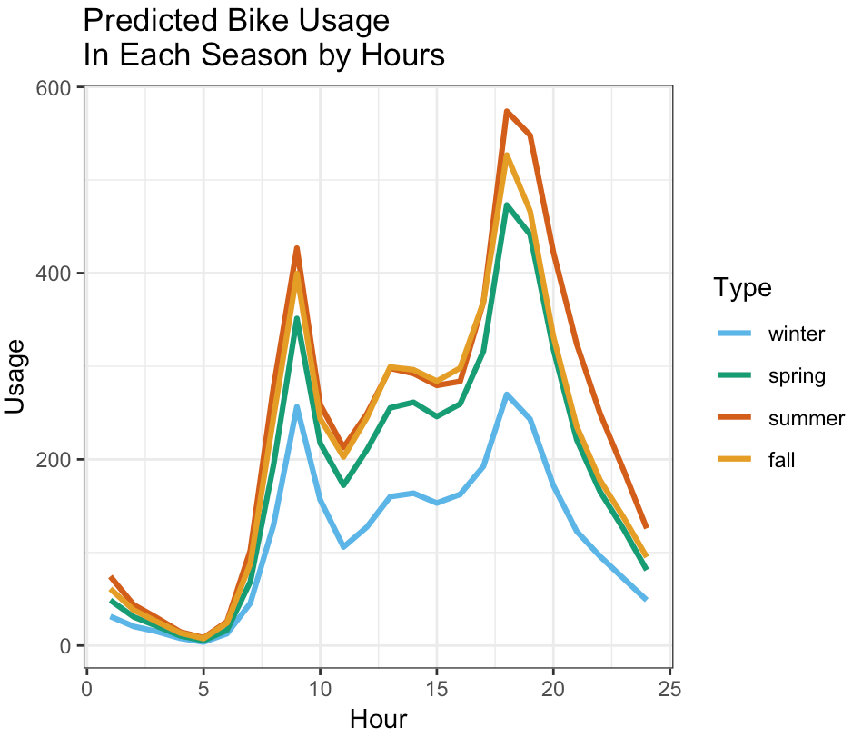
Poisson Prediction Model
Season x Hours + Normal Weather
Seasons
Notes:
Ling

Slide 14
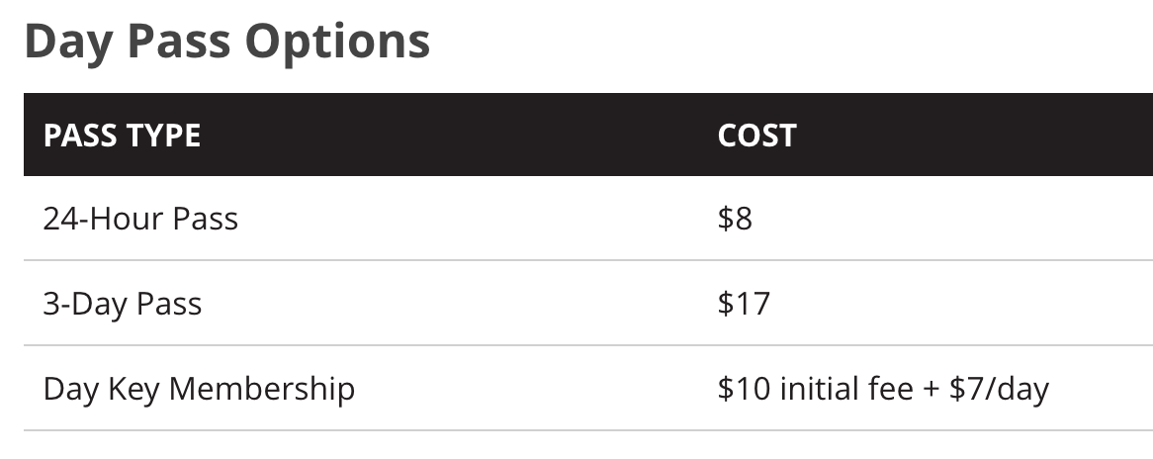
To answer the business questions - Promotions
Annual Membership
$85/year
30 Days Membership
$28/30 -Days
We would introduce a Weekend Pass for $12
pass valid starting 0:01 am Saturday till 11:59 pm Sunday
We would introduce a Seasonal Membership for $35
Membership valid for 3 consecutive months
Corporate Memberships
Notes:
Ling

Slide 15
To answer the business questions - Maintenance
To save on maintenance cost by adjusting the number of bikes put out on the streets at a different time of a year. For example, reduce the number of bikes in winter by half of the amount from summer.
Notes:
Ling

Slide 16

Thank You
Reference: Fanaee-T, Hadi, and Gama, Joao, 'Event labeling combining ensemble detectors and background knowledge', Progress in Artificial Intelligence (2013): pp. 1-15, Springer Berlin Heidelberg

